Slide 1

The SEAG
2026 Entrance Assessment

Slide 2
The 2026 Entrance Assessment
General Information
For pupils* who will be transferring from primary to post-primary school in September 2027.
All 63 schools in N. Ireland which use academic selection for all, or for a portion, of their admission to Year 8 are members of SEAG.
SEAG schools will use the outcomes from the 2026 Entrance Assessment within their 2027 Year 8 Admissions Criteria.
Parents / guardians who are considering one or more of these 63 schools for their child(ren) should register their child(ren) to sit the Entrance Assessment*.
*NB There is a separate Year 8 admissions procedure for children who have a formal “Statement of Special Educational Needs”. This procedure is run by the Education Authority and does not use SEAG Entrance Assessment Outcomes.

Slide 3
The 2026 Entrance Assessment
Key Dates
SEAG Pupil Registration Period
Monday 18th May 2026 (8.00am) – Friday 18th September 2026 (11.59pm)
SEAG Entrance Assessment Paper 1
Saturday 14th November 2026 (am)
SEAG Entrance Assessment Paper 2
Saturday 21st November 2026 (am)
SEAG Outcomes released to parents / guardians
Saturday 23rd January 2027
NB SEAG has set aside 28th November 2026 as a contingency Assessment Day. This date will only be used in the event that it is not possible to hold the Assessment at all on either 14th or 21st November 2026.

Slide 4
The 2026 Entrance Assessment
Really Important
Registration
Only pupils who have been registered to sit the Entrance Assessment (registration closes at 11.59pm on Friday 18th September 2026) will be able to sit the Assessment.
The Registration Period is open for 4 months – 124 days. DO NOT LEAVE IT TO THE LAST MINUTE !!
For 2025, SEAG was able to open a Late Registration Window for 4 days in September, with a non- refundable £50 Administration Fee. There is no guarantee that this window will be available in 2026.
If a pupil has not been registered he / she will NOT be able to sit the Entrance Assessment.
It is the responsibility of the parent / guardian to register their child.
SEAG Entrance Assessment Papers
The Entrance Assessment consists of two Assessment Papers taken one week apart.
Pupils sit both Papers. It is not a choice between sitting Paper 1 or Paper 2.

Slide 5
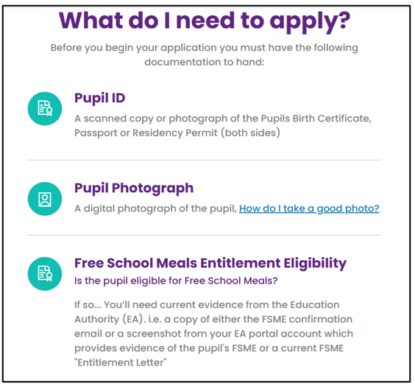
The 2026 Entrance Assessment
The Registration Process (Be Prepared)
Parents / Guardians will:
use a portal on the website www.seagni.co.uk to
register their child by completing a “Pupil Application”.
need to have the following documentation to hand:
Pupil’s Birth Certificate / Passport / Residence Permit
Pupil’s Photograph – a head and shoulders picture
and, if claiming exemption from the £20 registration fee:
Current Free School Meals Eligibility Entitlement (FSME)
approval documentation provided by the Education Authority (EA)
with the child’s name and date of birth:
i.e. EITHER an appropriate screenshot from the parent’s account in the EA portal
OR a current FSME “Entitlement Letter” from EA
NB FSME entitlement MUST be current; SEAG needs the EA approval documentation – not evidence that the parent has applied.

Slide 6
The 2026 Entrance Assessment
The Registration Process
(Learning from the past years’ experience)
Each year over 1000 parents have registered on the first day to try and make sure they were able to get a place at their preferred Assessment Centre BUT
there were still places at every Centre, even the most popular Centres, over two weeks later
AND there were still places at nearly every Centre over two months later.
Last year around 10% of all parents left it until the last week before trying to register and some forgot to register.
Last year there were errors in around 10% of Pupil Application forms.
Prepare well and take time to fill the form in accurately. There is a review page for you to check over what you have entered on the Pupil Application form.
There was no advantage last year in rushing to register on day 1, day 2, day 3, day 4, day 5 …….
There is a risk that, by leaving it too late, a pupil may not be registered at all and would not be able to sit the Entrance Assessment.

Slide 7
The 2026 Entrance Assessment
The Registration Process (Getting Started)
Parents / Guardians use a portal on the SEAG website www.seagni.co.uk
The process starts with the parent / guardian creating their own account in the portal.
We call this the Parent / Guardian Registration.
The portal is open from 8:00am Monday 18th May until 11.59pm Friday 18th Sept 2026.
SEAG provides Guidance Notes to help Parents / Guardians.
Parent / Guardian Registration involves providing an email address.
If a parent has more than one child sitting the Entrance Assessment then both Pupil Applications can be carried out using the same Parent Registration with the same email address.
If you set up a SEAG account in 2023, 2024 or 2025 and you have another child sitting the Entrance Assessment in 2026 you will need to set up a new account for 2026.
If you cannot access a smartphone, tablet, laptop or other electronic device to register your child on the SEAG website, please give your details, in writing, to the Assessment Centre and we will contact SEAG on your behalf.

Slide 8
The 2026 Entrance Assessment
The Registration Process (Getting Started)
Parent / Guardian Registration
NB Use an email address which you are confident you will still be using until February 2027 – after the results are issued.
NB The parent / guardian can choose to set up a recovery email address.
SEAG recommends that you do this.
If you set up a recovery email and, at some later point in time you cannot access your main email account, you can use the recovery email instead.
If you choose not to have a recovery email and, later, you cannot log into your main email account, it will not be possible for you to access your account, e.g. to edit information OR to download the Pupil Card OR to see your child’s SEAG Outcomes in January 2027.

Slide 9
The 2026 Entrance Assessment
The Registration Process-Pupil Application
Step 1 of 10 Pupil Details
Details about the pupil who is being registered are entered.
The name and date of birth which the parent / guardian enters MUST be identical to the information on the birth certificate / passport / residence permit for the Pupil Application to be valid.
Step 2 of 10 Pupil Photograph
A passport-style, “head and shoulders” photograph of the pupil is uploaded.
This photo will appear on the “Pupil Card” which a child brings to the the Assessment Centre to confirm their identity.
Step 3 of 10 Pupil ID*
A copy of the birth certificate / passport / residence permit is uploaded to confirm the identity of the pupil.
*If a child’s name has been changed by Deed Poll, then a copy of the Deed Poll, not the birth certificate / passport / residence permit, should be uploaded.
NB When registering their child, a parent / guardian can save the details and return later to complete the process.

Slide 10
The 2026 Entrance Assessment
The Registration Process (Step 4 of 10)
Step 4 Essential Information – for the days of the Assessment
The Assessment Centre provides pencils, erasers and rough work paper for your child.
If required, your child may bring a highlighter pen and / or a pencil grip.
If your child needs to have any other item with them, the parent / guardian must make an Application for Access Arrangements.
Examples of items which some children may need to bring and which fall under Access Arrangements include:
Medical Equipment e.g. EpiPen, Inhaler, Glucose Monitor;
Reading the Paper e.g. Coloured Overlay, Reading Ruler, Electronic Examination Reader Pen; Bilingual Dictionary;
Concentration Aid e.g. Fidget Toy, Ear Defenders.
NB The above list is for illustrative purposes only and is not exhaustive.

Slide 11
The 2026 Entrance Assessment
The Registration Process (Step 5 of 10)
Step 5 Will you need to request Access Arrangements?
Access Arrangements are “Reasonable Adjustments” made for the SEAG Entrance Assessment for children with specific, substantive needs.
At this step, parents/guardians must answer YES or NO to 4 important questions regarding Access Arrangements.
If the answer is “Yes” to any of these 4 questions, you will be directed to the detailed “Access Arrangements” Section later in the Pupil Application.
If you select “No” to all 4 questions, you will NOT be able to include an Access Arrangements request in your Pupil Application.

Slide 12
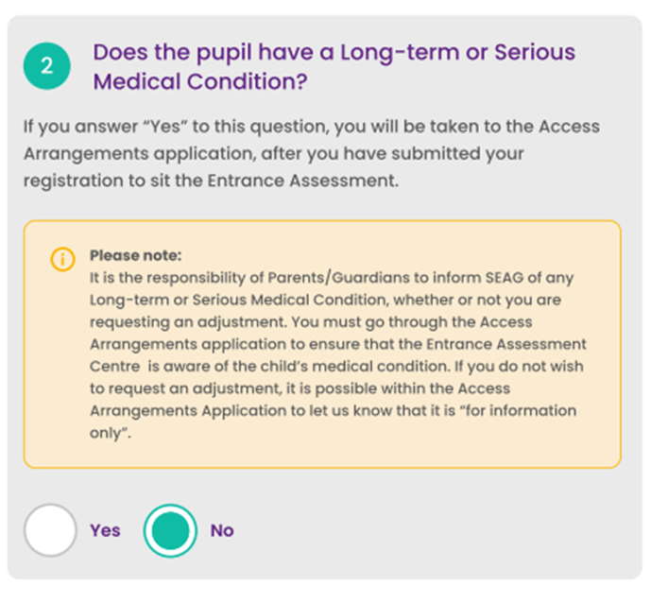
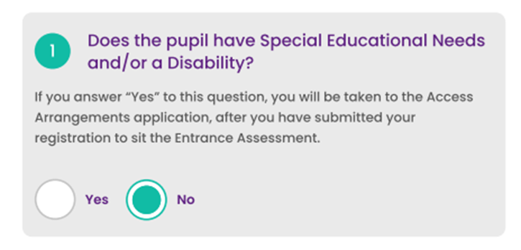
The 2026 Entrance Assessment
The Registration Process (Step 5 of 10)
Step 5 Access Arrangements? Questions 1 and 2

Slide 13
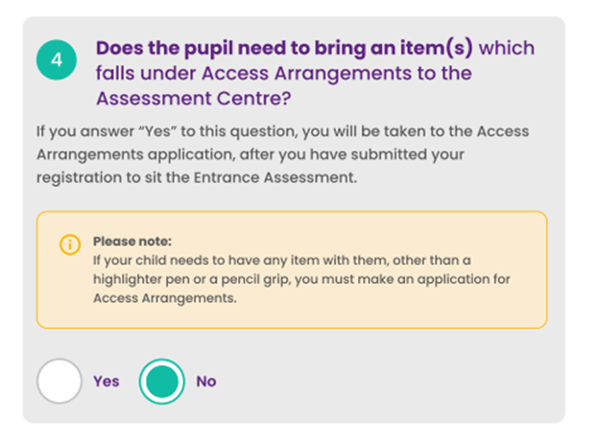
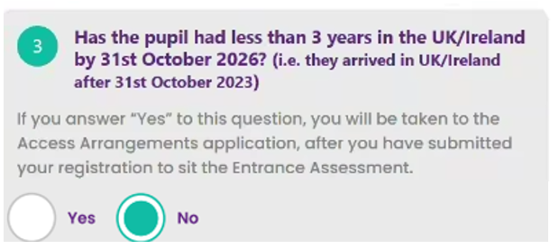
The 2026 Entrance Assessment
The Registration Process (Step 5 of 10)
Step 5 Access Arrangements? Questions 3 and 4

Slide 14
The 2026 Entrance Assessment
The Registration Process (Steps 6 and 7 of 10)
Step 6 Primary School Details
The parent / guardian enters details of their child’s primary school.
SEAG will pass this information to the Assessment Centre. Assessment Centres use this information to help them plan seating arrangements for the Assessment.
If the pupil is “home schooled” then “Home Educated” should be entered.
Step 7 Secondary Contact Details
The parent / guardian enters details of another contact person.
We need details of a second adult in case the parent / guardian who makes the Pupil Application cannot be contacted e.g. in an emergency.
The Second Contact can be the other parent / person with parental responsibility, or someone else.

Slide 15
The 2026 Entrance Assessment
The Registration Process (Step 8 of 10)
Step 8 Choosing the Assessment Centre
The parent / guardian selects, from a drop-down list, the SEAG school which would be most convenient for their child to sit the Entrance Assessment.
The drop-down list initially contains all 63 SEAG schools but, over time, a school could reach its maximum capacity. If that happens, that school will no longer appear in the list of choices.
Step 8 Assessment Language
Selecting “Gaeilge” directs the parent to a choice of the available Assessment Centres which provide the “Gaeilge version”. The Invigilation will be in Irish for those pupils.
12 of our Assessment Centres, across the country, can provide the “Gaeilge version” of the Entrance Assessment as well as the “English version”.
Do not be misled into thinking that, for 2026, a Centre will definitely use rooms or definitely use halls. Some decisions cannot be made until the end of September, when the school knows how many pupils are coming, what Access Arrangements are needed and what its resources are.

Slide 16
The 2026 Entrance Assessment
The Registration Process (Step 9 of 10)
Step 9 Review all the information you have included
Many submitted Pupil Applications can contain errors.
The “Review” page lets parents see everything they have added so that they can carefully check if it is all absolutely correct.
If there are any errors, e.g. the wrong Assessment Centre selected, name typed in doesn’t match the name on the ID document, then this is the opportunity to correct these errors.
Also check that the photographic ID and the birth certificate/passport/residence permit have uploaded correctly.
Step 9 Assessment Declaration
You will also need to:
confirm that all the information you have provided is accurate, that you accept any liability for providing inaccurate information and that you accept all responsibilities as parent / guardian of the pupil for whom this application is made;
agree to the Terms & Conditions.

Slide 17
The 2026 Entrance Assessment
The Registration Process (Step 10 of 10)
Step 10 Payment / Free School Meals Payment Exemption
As part of the Pupil Application process, the parent / guardian is required to pay a non-refundable administration fee of £20 through a secure online payment method.
Those entitled to Free School Meals (FSME) are exempt from the administration fee but must provide necessary verification, provided by the Education Authority (EA), of FSME status when registering.
Parents / Guardians will need to make sure that they have a debit / credit card available to make the payment OR
if payment is exempt through FSME, then current approval evidence of FSME which includes the child’s name and date of birth must be uploaded.
Evidence can be a copy of either:
a screenshot from the EA portal account which provides evidence of your child’s current FSME
OR a current FSM “Entitlement Letter” from the EA.

Slide 18
The 2026 Entrance Assessment
The Registration Process – After the Payment Step
When the Administration Fee payment has been made OR approved FSME payment exemption evidence has been submitted, the pupil’s place at the selected Assessment Centre is secured.
The Assessment Centre you selected will be where your child sits the Assessment.
Parents receive email confirmation that they have “registered a pupil, pending verification by SEAG”.
All Pupil Applications will be reviewed and verified by the SEAG team.
e.g. Do the name and date of birth on the birth certificate / passport / residence permit
match what the parent / guardian has entered? Is the photographic ID appropriate? If
FSME payment fee exemption has been claimed, was correct evidence provided?
SEAG will only contact parents if there is an issue with verifying the application.
You can check the status of your application at any time. As soon as SEAG has been able to verify an application, it will change from “pending” to “verified” on the portal.

Slide 19
The 2026 Entrance Assessment
The Registration Process (Additional notes)
Parents who answered “Yes” to 1 or more of the 4 “Access Arrangements” questions can submit the Access Arrangements request at a later time, within the Registration Period, if they choose.
After a parent submits an Access Arrangements Request, it is reviewed separately, by the Access Panel; the parent will receive an email once an Access Arrangements decision has been made.
FSME - If a claim for Free School Meals cannot be verified, because of inadequate evidence, the parent will be asked to provide the specific evidence which is needed. If they cannot do this, they will receive an email stating that payment is required.
Change of details - A parent / guardian can edit parts of the Pupil Application after submission, if e.g. the home address, contact number, email address or the pupil primary school have changed.
Changing Assessment Centre - to change the selected Assessment Centre after submitting the Pupil Application, parents must complete a new Pupil Application and withdraw the old one.
Pupil Card - Pupils bring this to the Assessment Centre on 14th and 21st Nov. 2026. Parents can download the Pupil Card, which includes the photo that they uploaded, from about 9th Oct. 2026.

Slide 20
The 2026 Entrance Assessment
The Registration Process - Requesting Access Arrangements
It is really important to read the “Access Arrangements Policy, Procedures and Guidance”.
In the Access Arrangements Section of the Pupil Application, parents / guardians outline details of their child’s need.
If an Access Arrangement is being requested, parents indicate the relevant Access Arrangements AND upload the documentary evidence to support the request(s).
NB Before the Access Arrangements Section is submitted, parents can edit their Access request(s) and add to or amend uploaded supporting evidence as much or as often as they need to.
NB After the Access Arrangements Section has been submitted, it is not possible to edit, add to or amend what has been submitted.
NB Please only submit the Access Arrangements Section when you have ensured that you have included all the Access requests you wish to apply for and you have uploaded all the supporting evidence.

Slide 21
The 2026 Entrance Assessment
The Papers (1)
Details, including the format and specification of the Entrance Assessment, are provided on the SEAG website (www.seagni.co.uk) – in the “Guidance for Parents” Section.
Two SEAG Practice Papers, along with Practice Answer Sheets, in both English and Gaeilge, are also provided, along with a Guide for Parents with the Answer Keys for each question on each Paper.
Summary:
The Entrance Assessment consists of Paper 1 and Paper 2.
Both Papers have an identical format which is the same as that of the SEAG Practice Papers which are available, at no cost, on the SEAG website.
Each starts with a Practice Test section containing 5 English (or Gaeilge) questions and 5 Maths questions.
The Practice Test section allows pupils time to settle and practise answering the same types of questions as those in the Main Paper but without those questions being marked or timed.
The Practice Test section is followed by an English (or Gaeilge) section which has 28 questions and then a Maths section which also has 28 questions.

Slide 22
The 2026 Entrance Assessment
The Papers (2)
The English (or Gaeilge) begins with a punctation exercise (5 questions), followed by a grammar exercise (5 questions) and a spelling exercise (5 questions). All 15 questions are multiple choice.
Next, pupils are asked to read a comprehension passage and answer 13 questions which follow. Questions 16-22 are multiple choice and questions 23-28 are “free response” where the pupil writes a short answer to each in the space provided in the Answer Sheet.
Spelling is only assessed in the spelling exercise, NOT in the free response answers.
The first 22 Maths questions (29-50) are multiple choice and the final 6 questions (51-56) are “free response” where the pupil writes a short answer to each in the space provided in the Answer Sheet.
Invigilators tell the pupils when to start the Main Test and that pupils will have 60 minutes* to work through the paper (*unless granted additional time through Access Arrangements).
Invigilators will also tell pupils when they have about 30 minutes left and when they have about 10 minutes left. (Timing prompts are slightly different for those with additional time.)
When completing a multiple-choice answer on the Answer Sheet, a pupil may draw a horizontal line OR shade in the little box. Both are equally acceptable.
Each pupil is free to begin the Main Test with either the English (or Gaeilge) or the Maths section.

Slide 23
The 2026 Entrance Assessment
SEAG Outcomes (1)
Parents / Guardians receive a Statement of Outcomes which has five main outcomes (or results) for their child.
The first two outcomes are the ones most likely to be used by SEAG schools within their Year 8 Admissions Criteria.
The other three outcomes provide additional information for parents and schools.
The Total Standardised Age Score (TSAS)
The Band
The English / Gaeilge SAS
The Maths SAS
Information about the Cohort Percentile Ranking
In addition, parents are provided with a range of other outcomes relating to e.g. how many questions their child answered correctly in English (or Gaeilge) and in Maths and how their child performed in Paper 1 and in Paper 2.

Slide 24
The 2026 Entrance Assessment
SEAG Outcomes (2)
1. The Total Standardised Age Score (TSAS)
This is the pupil’s overall outcome from the SEAG Entrance Assessment based on answers to the 56 English (or Gaeilge) Questions in Papers 1 and 2 and the 56 Maths questions in Papers 1 and 2.
The Total SAS is the sum of the English / Gaeilge SAS and the Maths SAS.
The Total SAS range will be 138-282 with a mean (or average) of 200.
A Standardised Age Score (SAS) takes account of a child’s age when he/she took the assessment, the number of correct answers and the degree of difficulty of the assessment.
Parents / Guardians may be familiar with the scores from standardised tests used in their child’s primary school, e.g. Progress Test in English and / or Progress Test in Maths, which also use SAS.

Slide 25
The 2026 Entrance Assessment
SEAG Outcomes (3)
2. The Band
There are six Bands.
The Bands are designated as Band 1, Band 2, Band 3, Band 4, Band 5 and Band 6.
Cohort Percentiles are used to determine the borderline for each Band (See Outcomes (5).
60%+ (Band 1) means pupils who are in the top 40% of those who sat the Assessment; 50-59% (Band 2) means pupils who are in the top 50% but not the top 40% of those who sat the Assessment, etc.
SEAG Band | 1 | 2 | 3 | 4 | 5 | 6
Cohort Percentile | 60%+ | 50-59% | 40-49% | 30-39% | 20-29% | <20%

Slide 26
The 2026 Entrance Assessment
SEAG Outcomes (4)
3. The English / Gaeilge SAS
This is the Standardised Age Score based on answers to the 56 English (or Gaeilge) questions.
The English / Gaeilge SAS range is 69-141 with a mean (or average) of 100.
The English / Gaeilge SAS is provided to inform parents as to how their children have performed in this aspect of the Entrance Assessment.
4. The Maths SAS
This is the Standardised Age Score based on answers to the 56 Maths questions.
The Maths SAS range is 69-141 with a mean (or average) of 100.
The Maths SAS is provided to inform parents as to how their children have performed in this aspect of the Entrance Assessment.

Slide 27
The 2026 Entrance Assessment
SEAG Outcomes (5)
5. Information about the Cohort* Percentile Ranking (CPR)
60%+ (Band 1) means that the pupil’s outcomes are in the top 40% of those who sat the Assessment.
50-59% (Band 2) - outcomes are outside the top 40% but in the top 50% of those who sat the Assessment.
40-49% (Band 3) - outcomes are outside the top 50% but in the top 60% of those who sat the Assessment.
30-39% (Band 4) - outcomes are outside the top 60% but in the top 70% of those who sat the Assessment.
20-29% (Band 5) - outcomes are outside the top 70% but in the top 80% of those who sat the Assessment.
<20% (Band 6) - the pupil’s outcomes are outside the top 80% of those who sat the Assessment.
* “Cohort” means everyone who sits the SEAG 2026 Entrance Assessment.

Slide 28
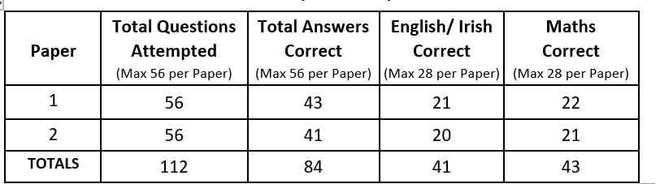
The 2026 Entrance Assessment
SEAG Outcomes (6)
SEAG provides parents with all the Outcomes information we hold about their child.
In addition to the 5 main Outcomes there are 12 “raw score” Outcomes.
The 5 main Outcomes are standardised and take account of how a child performed in their English / Gaeilge and in their Maths when compared with all the other pupils who sat the Assessment - “the cohort”.
The “raw score” outcomes are not standardised. They tell how many questions a child answered correctly, but provide no information as to how those scores compare with those of all the pupils who sat the Assessment.

Slide 29
The 2026 Entrance Assessment
SEAG Outcomes (7)
There are a number of reasons why parents receive different types of Outcomes including:
Academically selective schools tend to use 2 main types of outcomes within their Year 8 Admissions Criteria. Some choose to rank order using TSAS, others use SEAG Bands and some use both. SEAG is, therefore, providing TSAS and Bands.
Calculating the English/Gaeilge SAS and, separately, the Maths SAS means that both subjects have equal weighting in the Assessment.
Providing the English/Gaeilge SAS and the Maths SAS may be helpful to parents, primary schools and post-primary schools.
Some parents find it helpful to have a further breakdown of their child’s results relating to e.g. how many questions their child answered correctly in English (or Gaeilge) and in Maths and also how their child performed in Paper 1 and in Paper 2.

Slide 30
The 2026 Entrance Assessment
Sitting just one of the two Papers
SEAG is very clear that its Entrance Assessment consists of two papers.
Pupils who only take one paper (i.e. either Paper 1 or Paper 2 but not both) will not have completed the full Entrance Assessment.
Such pupils will, however, have their “single paper” marked by GL Assessment.
The SEAG Board has determined that pupils who only sit one paper should be provided with SAS and Band outcomes which reflect their performance.
Outcomes for pupils who only sit one paper will have the designation “e” (for estimate) immediately after the Outcome, e.g. SAS 196e; Band 3e.
It is the responsibility of each academically selective school (NOT SEAG) to set out, within its 2027 Year 8 Admissions Criteria, how it will treat estimated outcomes. e.g. through “Special Provisions”.

Slide 31
The 2026 Entrance Assessment
Role of a SEAG school with P7 parents and pupils (1)
After the Registration Period has ended, SEAG will make available, to each Assessment Centre, a file containing details of every pupil registered to sit the Entrance Assessment in that school.
Each SEAG school (Assessment Centre) will:
make all the practical arrangements for the pupils who will be sitting the Entrance Assessment in their school (Assessment Centre).
by mid-October 2026, communicate directly with each parent / guardian whose child(ren) are sitting the Assessment in their school.
provide practical details e.g. about dropping off children before the Assessment and collecting them afterwards.
liaise with parents / guardians as appropriate e.g. if there are particular medical or other needs.

Slide 32
The 2026 Entrance Assessment
Role of a SEAG school with P7 parents and pupils (2)
It is envisaged that each Assessment Centre will hold a familiarisation session in the Centre by 7th November 2026 to help children prepare for their time there on 14th and 21st November 2026.
Parents / guardians have the responsibility to ensure that their children arrive in the SEAG Assessment Centre in good time on the Entrance Assessment days.
Pupils can only be admitted to the Assessment Centre if they are registered to sit the Entrance Assessment.
Pupils cannot be admitted to the Assessment Centre room / hall after the Assessment has started.
If a child cannot attend on one of the two Entrance Assessment dates the parents/guardian must inform the Assessment Centre as soon as it is practically possible to do so.
Pupils who are absent on one of the two days will only sit part of the full Entrance Assessment.

Slide 33
The 2026 Entrance Assessment
For further information about SEAG and the 2026 Entrance Assessment,
including Registration, visit www.seagni.co.uk
The “Guidance for Parents” Section includes: Frequently Asked Questions, a list of the 63 member schools, along with various resources such as The Specification, The Format, Practice Papers, Practice Answer Sheets and the Access Arrangements documentation.
OR check out Facebook@SEAG NI OR Instagram @SEAG_NI_Official
NB Parents / Guardians can email SEAG directly from the SEAG portal as soon as they have created an account.
SEAG 29th April 2026

