Slide 1
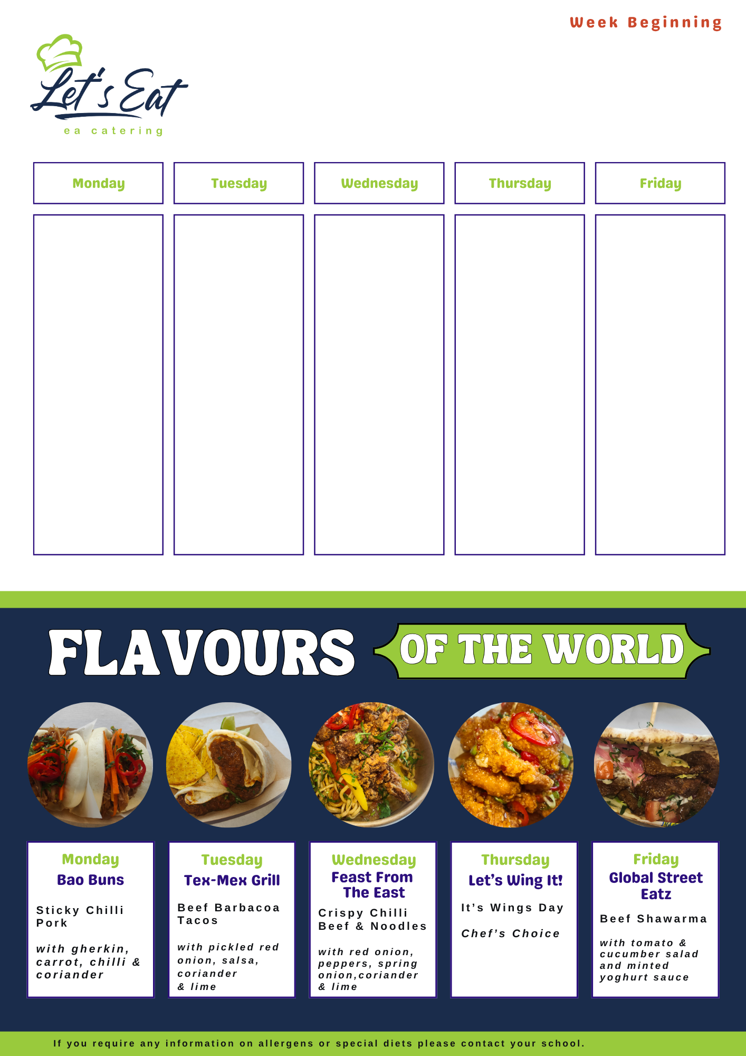
Glenlola Collegiate
Week 1
16.02.26 02.03.26
16.03.26 30.03.26
13.04.26 27.04.26
11.05.26 25.05.26
01.06.26 15.06.26
29.06.26
Soup of the Day
Homemade Wheaten Bread / Petit Pan
Chicken Curry Boiled Rice & Naan Bread
Selection of Freshly Made Paninis
Steak Burger/ Cheeseburger
Baked Beans
Baked Potatoes
Mixed Salads
Peas & Carrots
Pepper / Curry Sauce
Chips
Fresh Fruit Pots
Fruit Jellies
Frozen Yogurts
Ice Cream Tubs
Homemade Cookie
Soup of the Day
Homemade Wheaten Bread / Petit Pan
Bolognese Beef Pasta & Garlic Slice
Homemade Margarita Pizza
Selection of Freshly Made Paninis
Crumbed Chicken Fillet Burger in Brioche Bap with Mayo Lettuce & Tomato
Tomato & Basil or Pesto Pasta
Fresh Fruit Pots
Fruit Jellies
Mixed Yogurts
Chocolate Sponge & Custard
Soup of the Day
Homemade Wheaten
Bread / Petit Pan
Chicken Curry Boiled Rice & Naan Bread
Hot Dog & Crispy Onions
Selection of Freshly Made Paninis
Steak / Cheeseburger
Mixed Salads
Seasonal Veg
Chips / Baby Boils
Baked Potatoes Filled
Fresh Fruit Pots
Ice-Cream Tubs
Fruit Jellies
Apple Crumble & Custard
Homemade Cookie
Soup of the Day Homemade Wheaten Bread / Petit Pan
Roast of the Day with Stuffing & Gravy
Seasonal Veg
Roast and Mashed Potatoes
Selection of Freshly Made Paninis
Homemade Pepperoni Pizza / Margarita
BBQ Pulled Wrap
Stuffed Baked Potatoes
Fresh Fruit Pots
Fruit Jellies
School Cake & Custard
Frozen & Fresh Yogurts
Shortbread
Soup of the Day Homemade wheaten Bread / Petit Pan
Selection of Freshly Made Paninis
Chicken Curry Boiled Rice & Naan Bread
Breaded Whiting Slice of Lemon & Tartare Sauce
Mushy Peas / Petit Pois
Breaded Southern Fried Chicken Goujons
Chips / Baked Potatoes
Mixed Salads
Spaghetti Hoops
Curry & Pepper Sauce
Fresh Fruit Pots
Jellies & Yogurts
Homemade Wheaten Biscuits

Slide 2
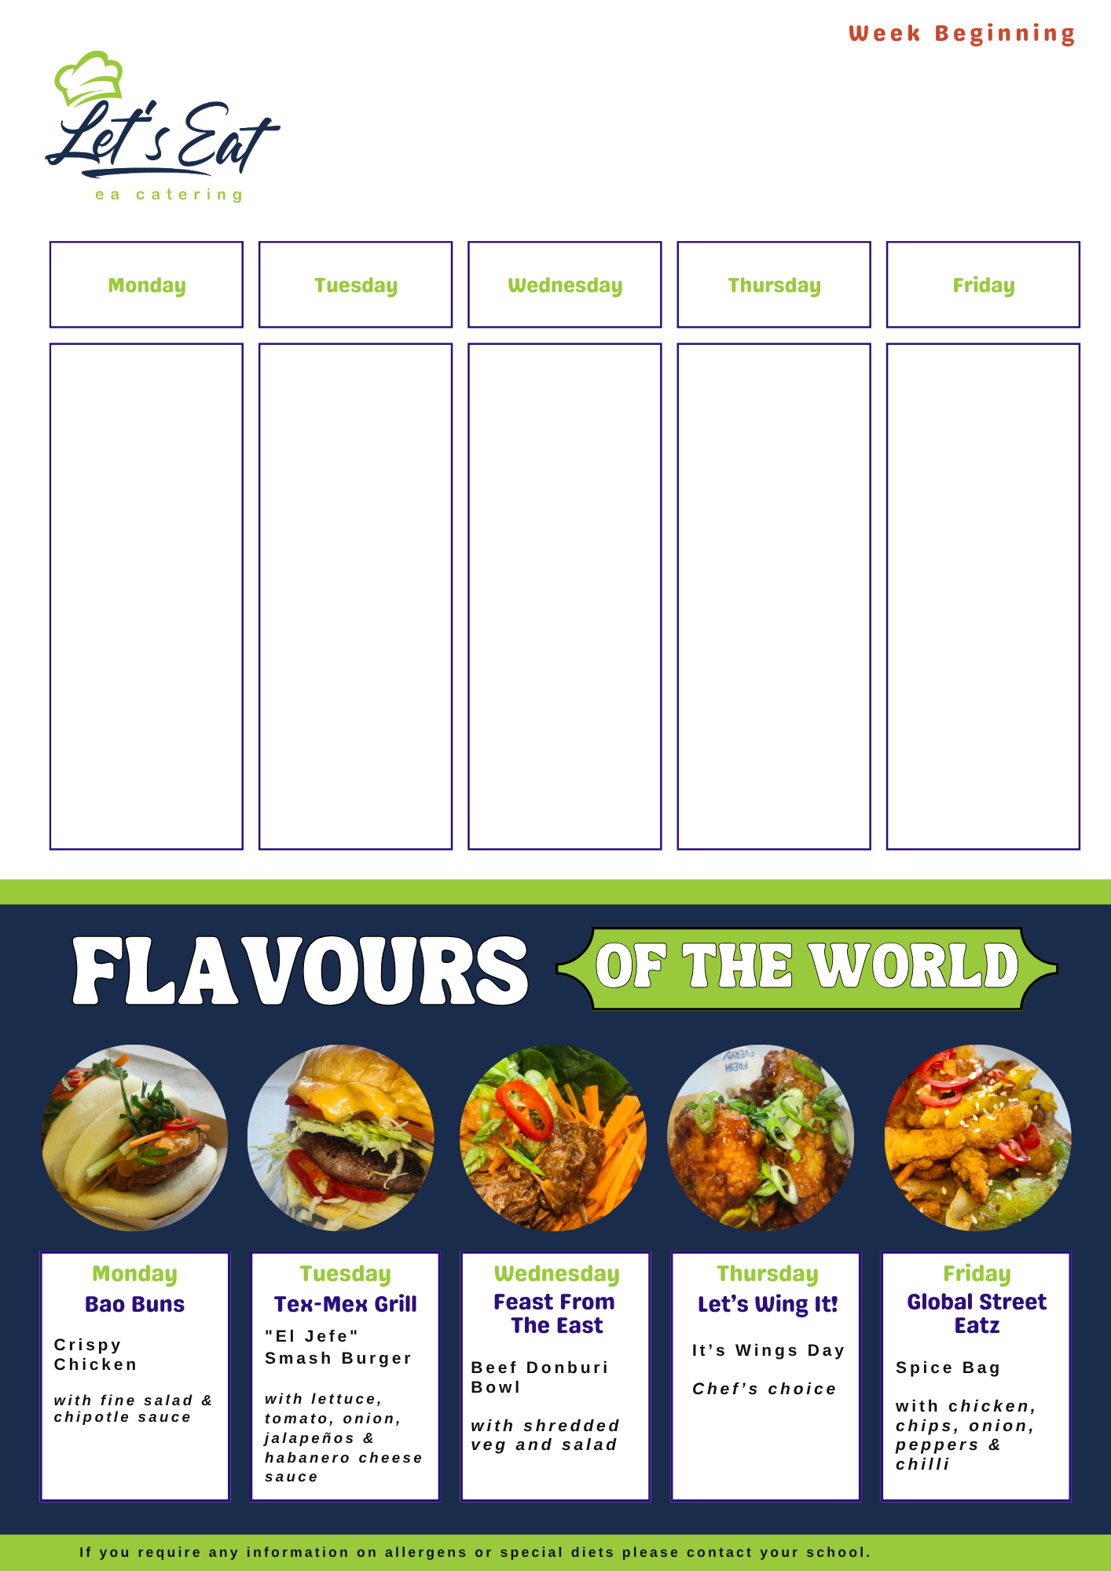
Glenlola Collegiate
Week 2
23.02.26 09.03.26
23.03.26 06.04.26
20.04.26 04.05.26
18.05.26 08.06.26
22.06.26
Soup of the Day Homemade Wheaten Bread / Petit Pan
Beef Lasagna & Garlic Slice
Chicken Curry Boiled Rice & Slice of Naan
Homemade Pizza
Selection of Freshly Made Paninis
Baked Potatoes
Chips
Curry & Pepper Sauce Loaded Fries
Mixed Salads & Veg
Baked Beans
Fresh Fruit Pots
Fruit Jelly
Frozen & Fresh Yogurts
Homemade Cookie
Soup of the day Homemade Wheaten Bread / Petit Pan
Chilli Beef Nacho Bowl
Salsa & Sour Cream
Crumbed Chicken Fillet Burger in Brioche Bap Lettuce & Mayo
Selection of Freshly Made Paninis
Homemade Pizza Slice
Baked Potatoes
Mixed Salads
Angel Cake & Custard
Fresh Fruit Pots
Fruit Jelly
Frozen Yogurts
Muffin / Cookie
Soup of the day Homemade Wheaten Bread / Petit Pan
Katsu Chicken Curry Boiled Rice & Naan Bread
Tomato & Basil Meatball Pasta
Selection of Freshly Prepared Paninis
Baked Potatoes
Chips
Curry & Pepper Sauce
Mixed Salads
Seasonal Veg
Fresh Fruit Pots
Fruit Crumble & Custard
Variety of Fresh & Frozen Yogurts
Mixed Ice-cream Tubs
Wheaten Biscuits
Soup of the day Homemade Wheaten Bread / Petit Pan
Roast of the Day Roast & Mashed Potatoes Seasonal Veg Savory Stuffing & Gravy
Selection of Freshly Prepared Paninis
Homemade Pizza slice
Chicken & Broccoli Bake
Seasonal Veg
Stuffed Baked Potatoes
Fresh Fruit Pots
Homemade Ginger Cookie
Fresh & Frozen Yogurts
Cheese & Crackers
Soup of the day Homemade Wheaten Bread / Petit Pan
Breaded Whiting Tartare sauce & Slice of Lemon
Mushy Peas
Chicken Goujons
Mixed Salad
Peas & Sweetcorn
Pizza Slice
Baked Potatoes
Chips
Pepper & Curry Dip
Selection of Freshly Prepared Paninis
Fresh fruit Pots
Chocolate Brownie
Ice cream Tubs
Fruit Jelly

