Slide 1


EXCELLENCE through
COMMITMENT, CONTRIBUTION
and CARING

Slide 2


Slide 3















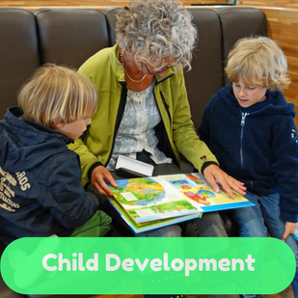





  Strong academic tradition
  School ethos
    High expectations and lots of support
  Large School
    A wide variety of ways to succeed

Slide 4

  To the life of Glenlola Collegiate
  To the School House System
  To the School Council – Your voice
  To Extra-curricular Programme

Slide 5



Our Houses are a long-standing tradition and an important and vibrant part of school life.
Each pupil is assigned to one of six Houses.
Clanmorris, Dufferin, Hamilton, Harte, Ward and Weir.
You can represent your House in competitions:
  Sports
  Choral
  Dance
  Bake off ..to name a few!

Slide 6
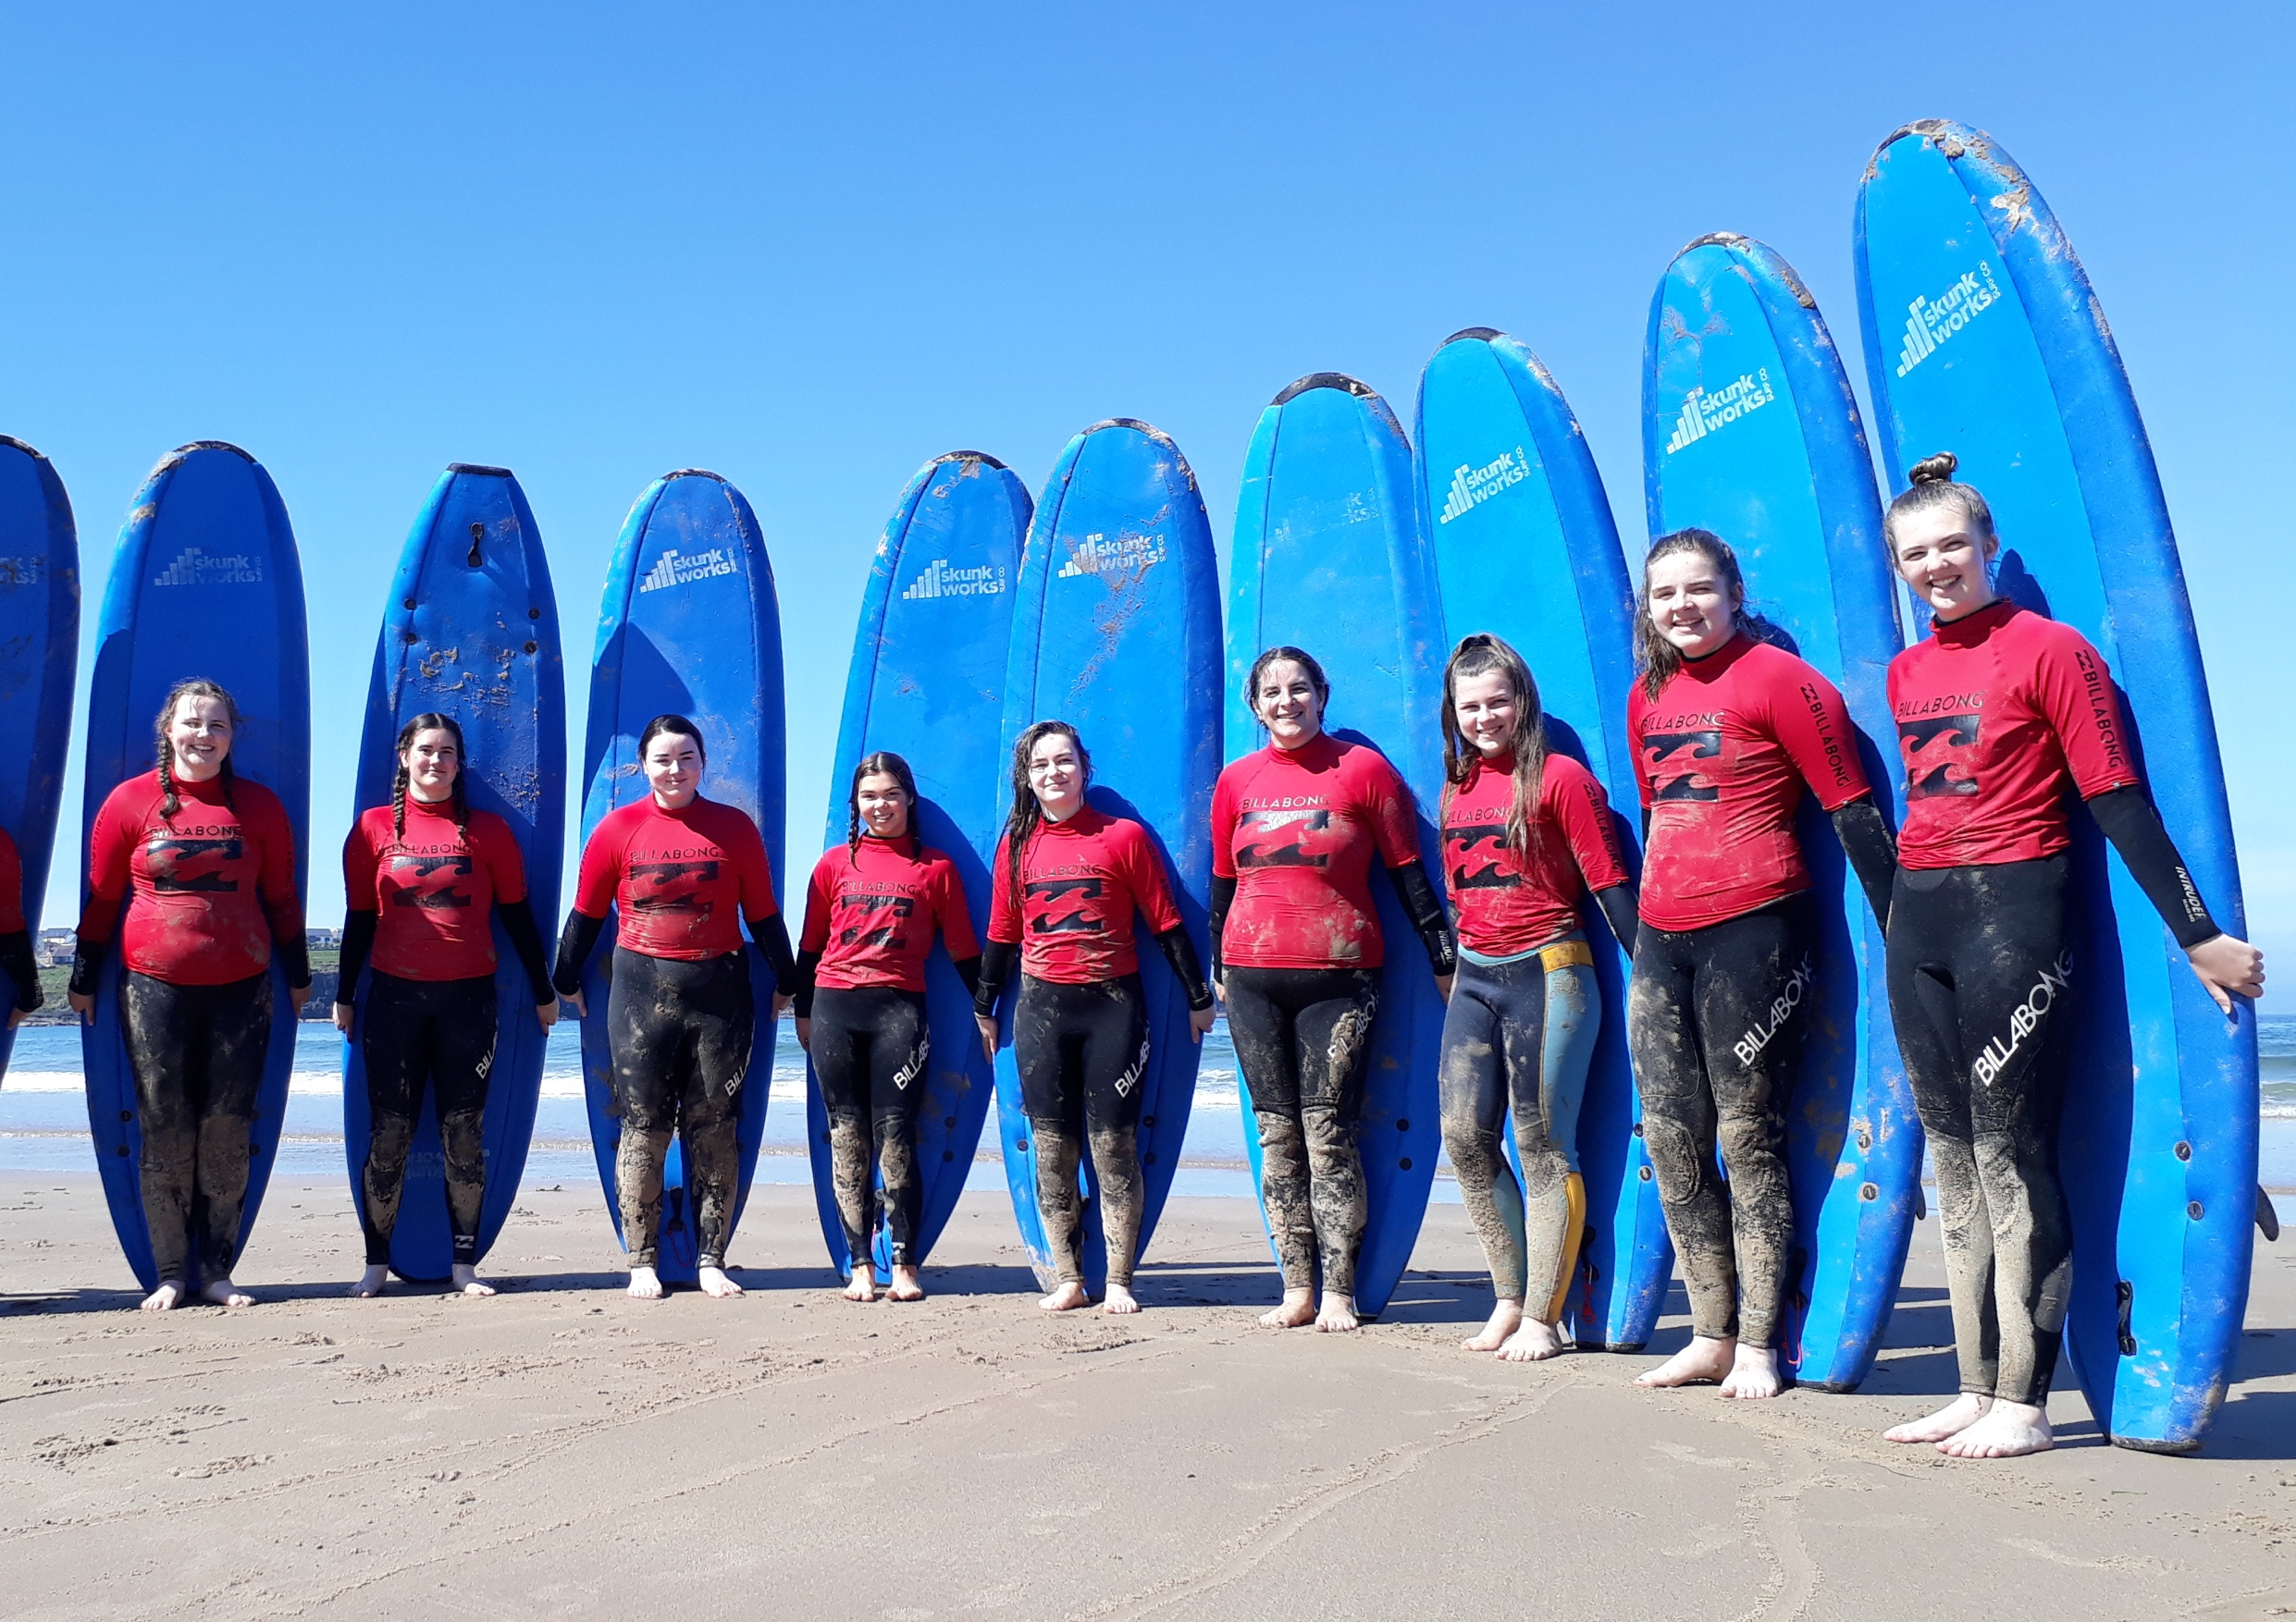

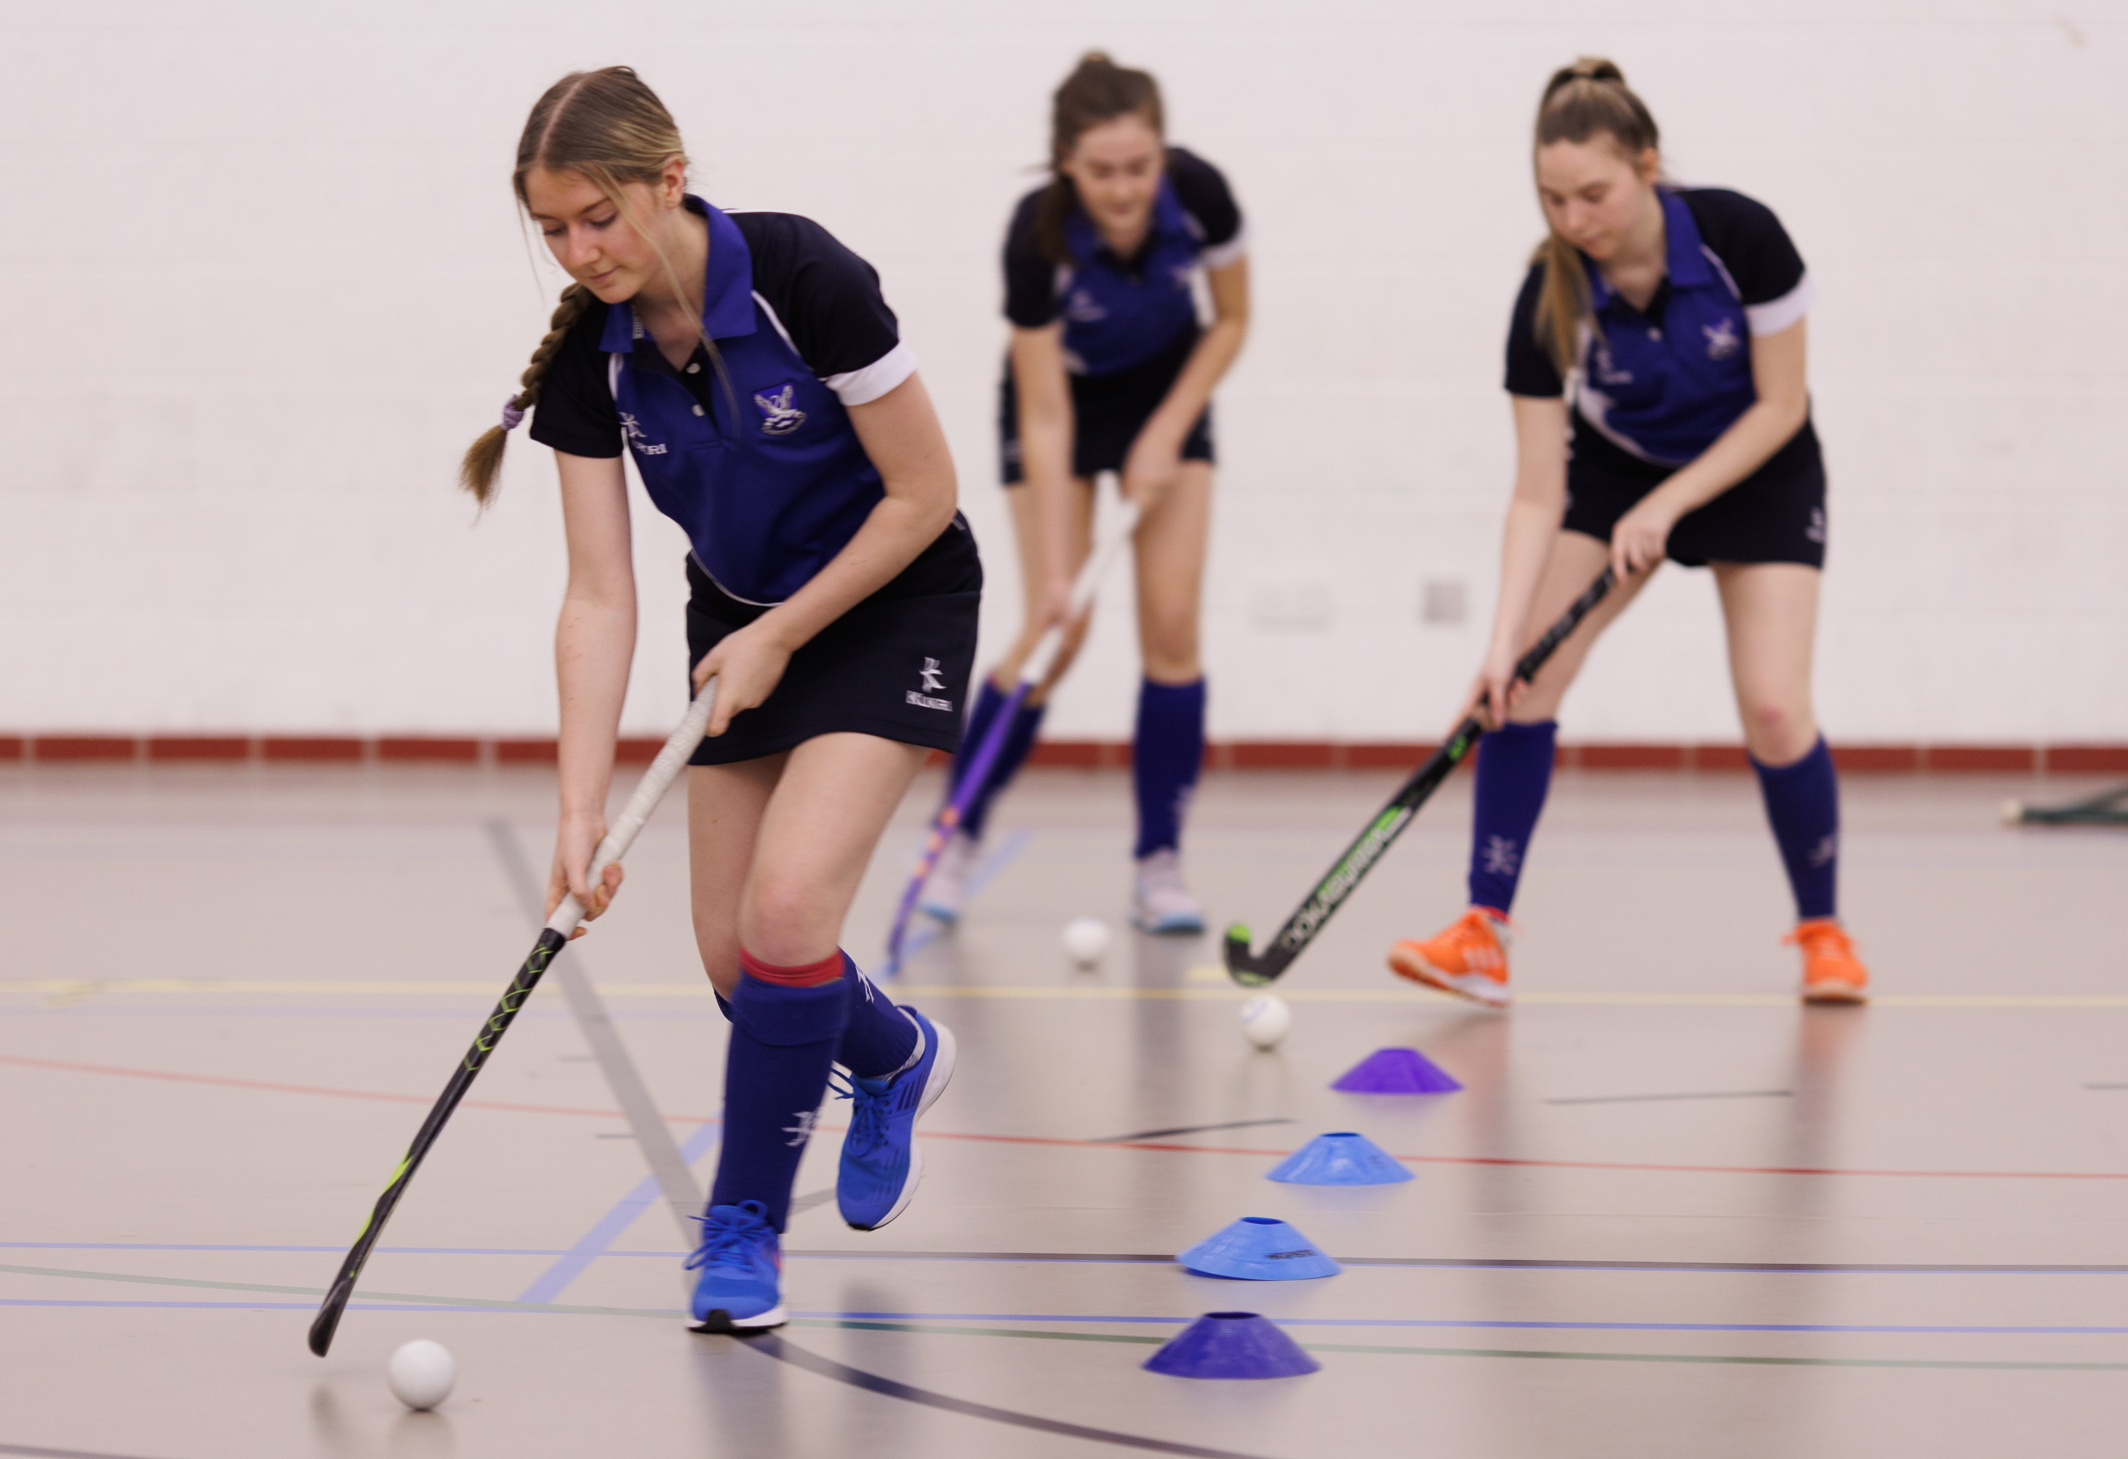
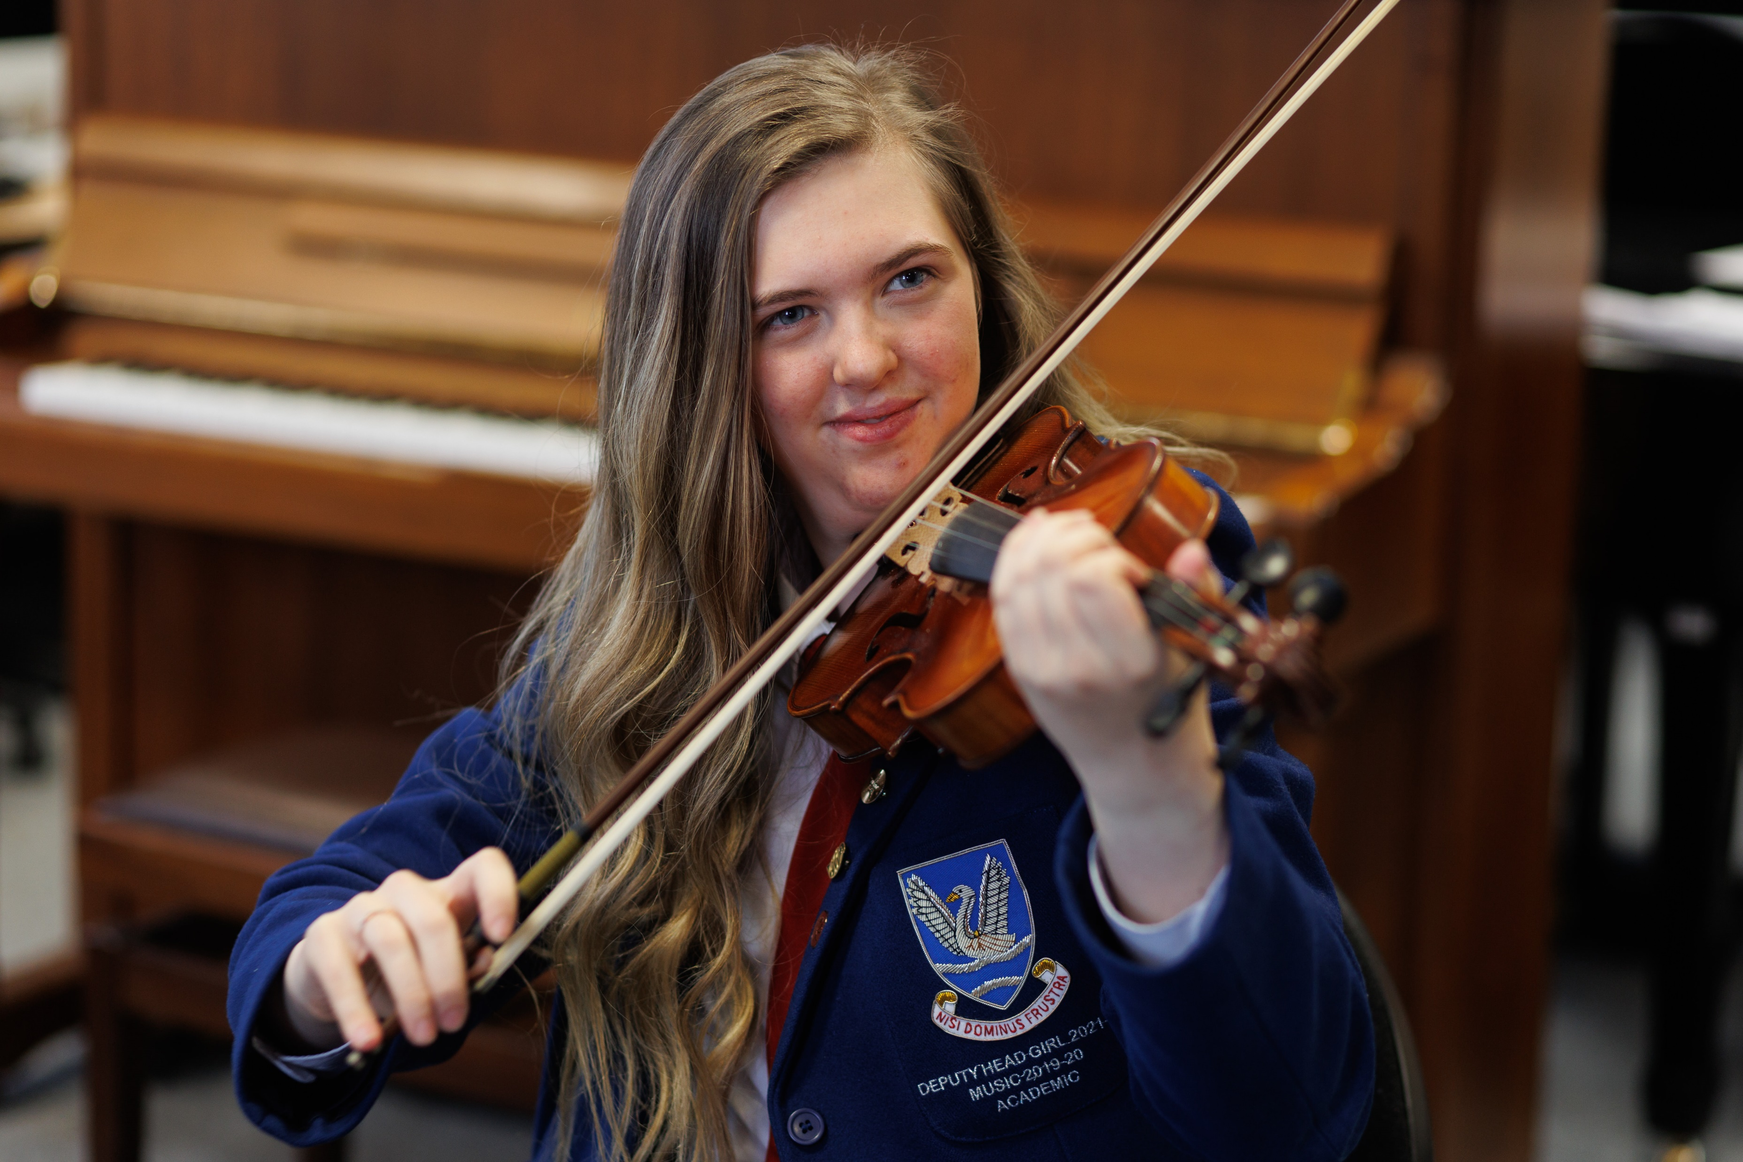
In Glenlola, we have a wide range of extra-curricular activities suitable for all interests.

Slide 7
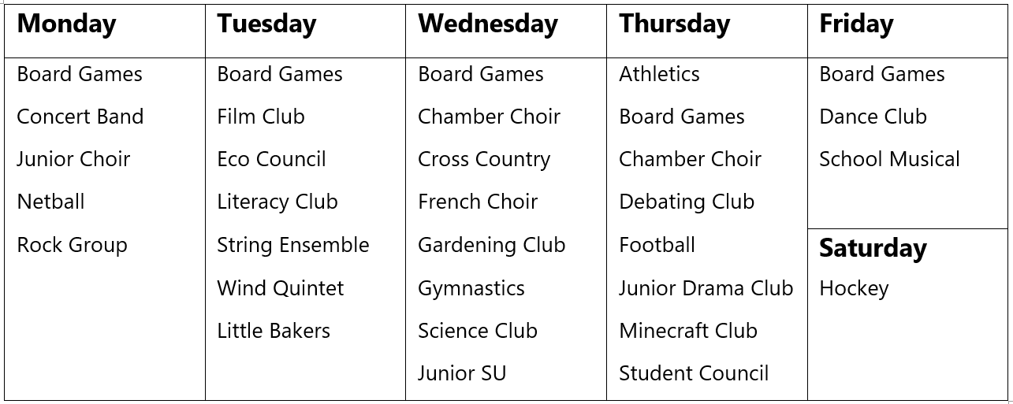

Slide 8

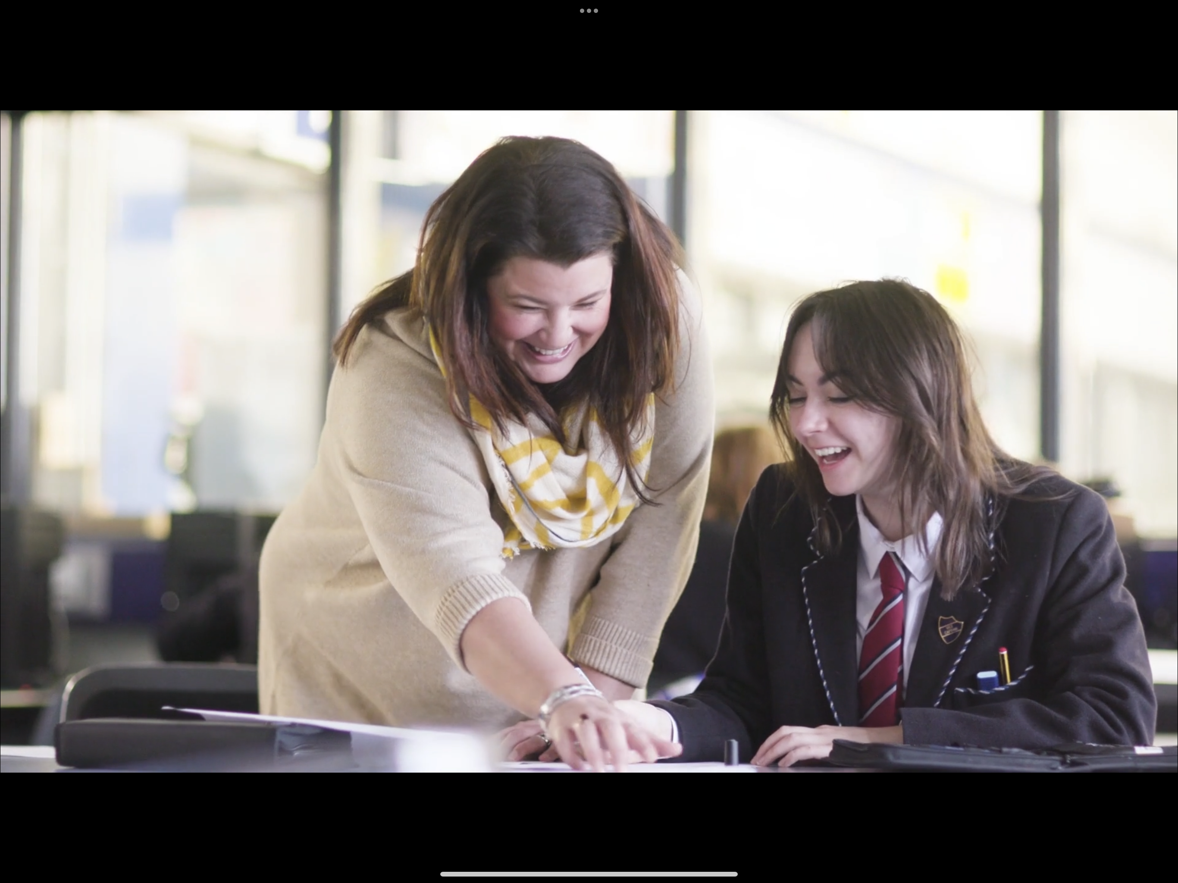
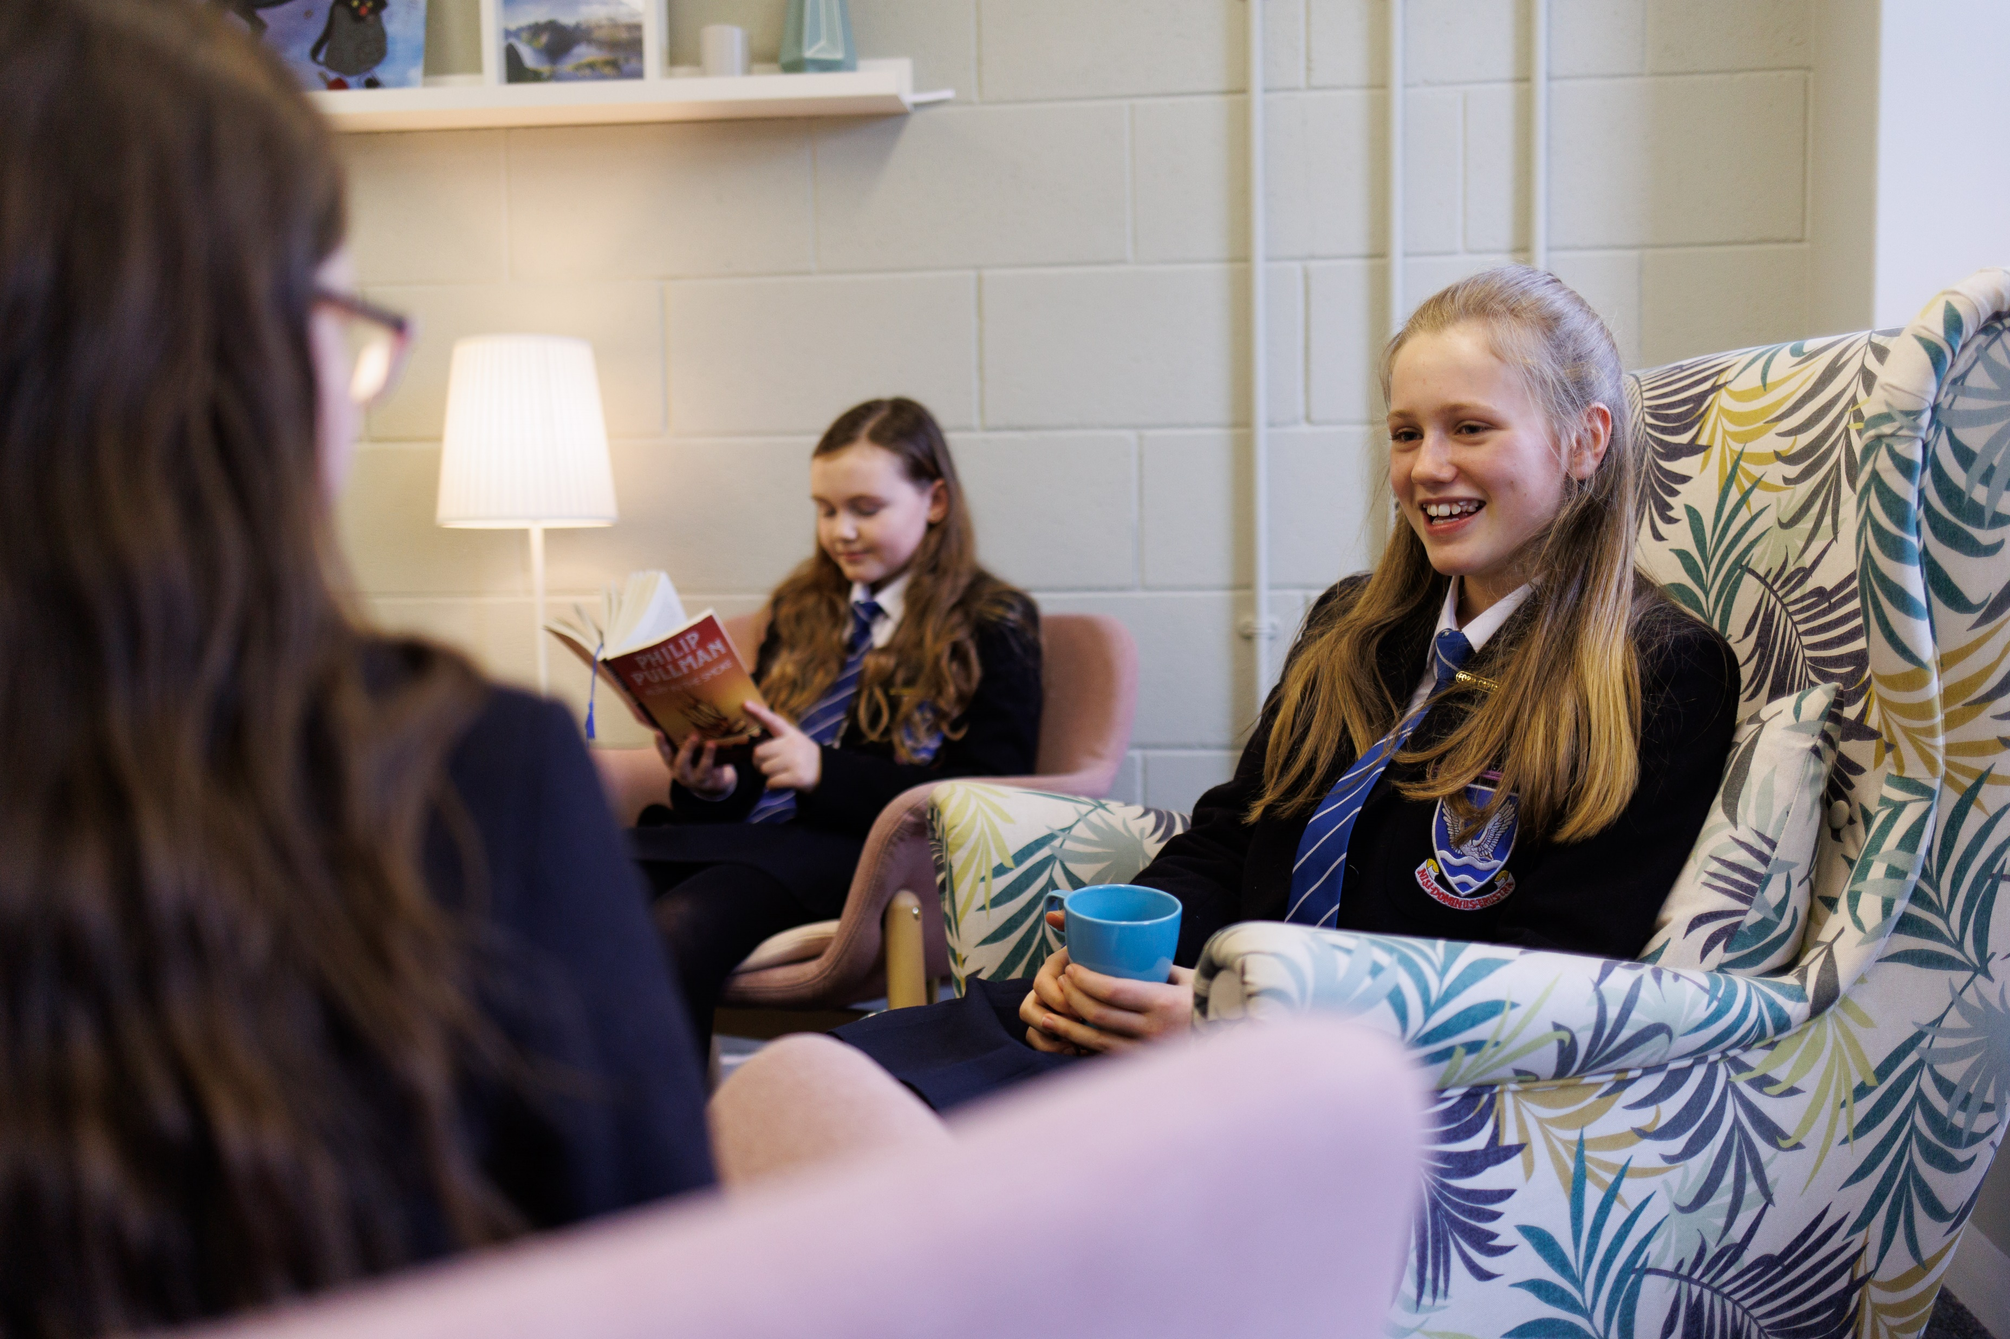
  The School community
  Pastoral Team
  School Counsellor
  School Nurse
  Mutual Respect and support
  Peer Mentoring and
  Peer Listening
  Wellness Centre

Slide 9
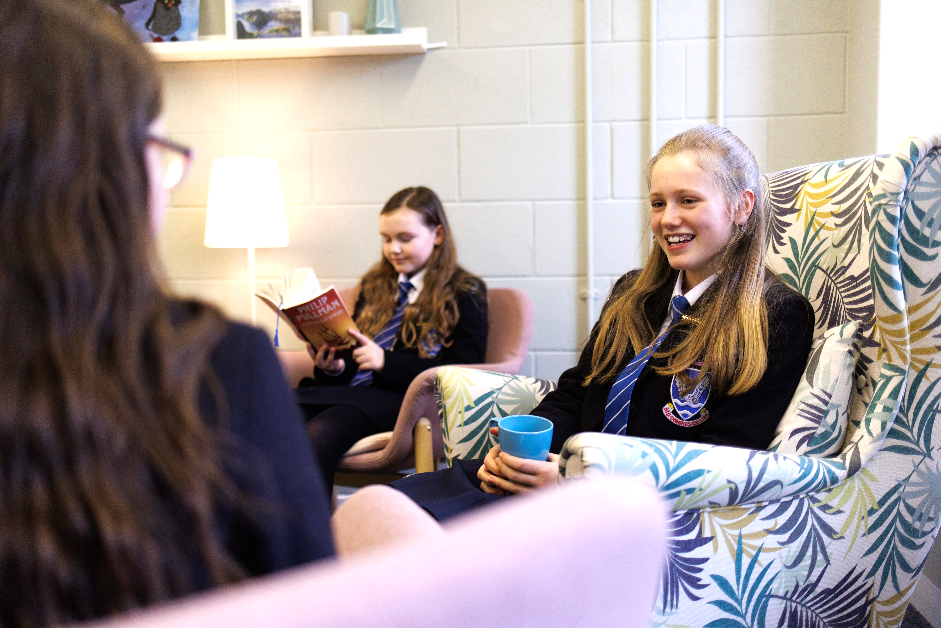
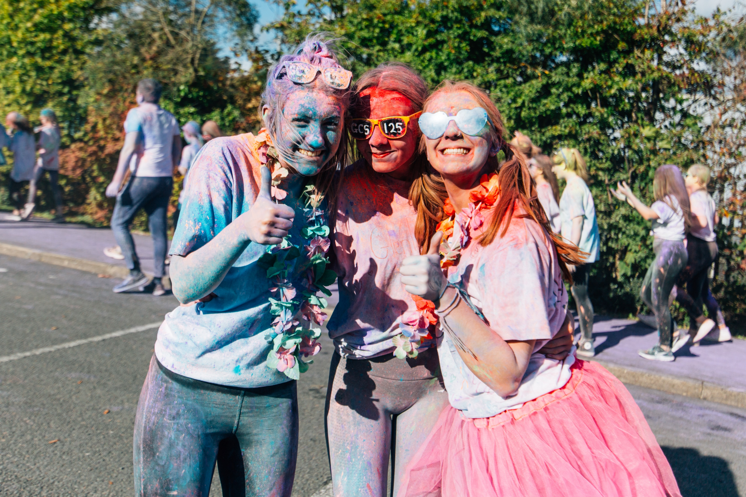

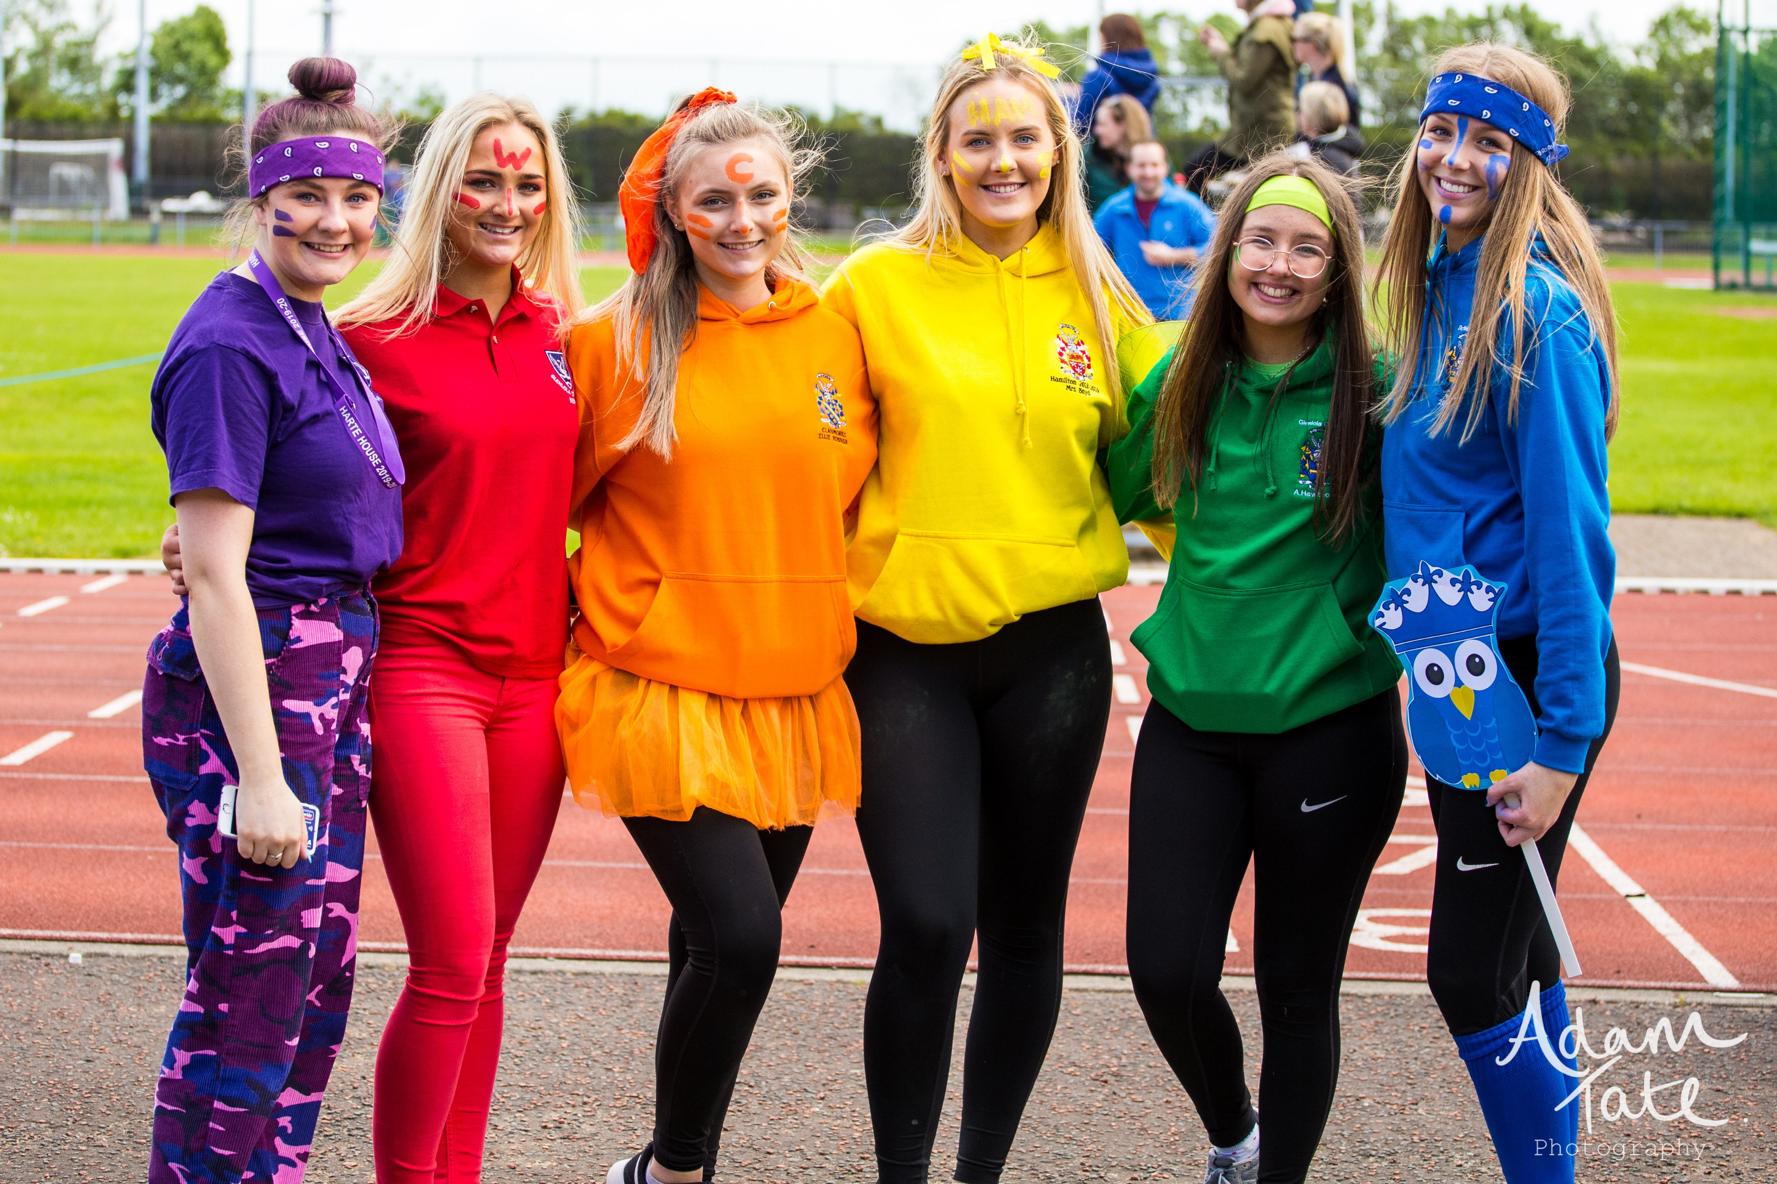
Check out the School Website for our

Slide 10


We’d love you to visit us:
“Oliver” Musical – 13-16 January
Open Night – Thursday 22 January

