Slide 1
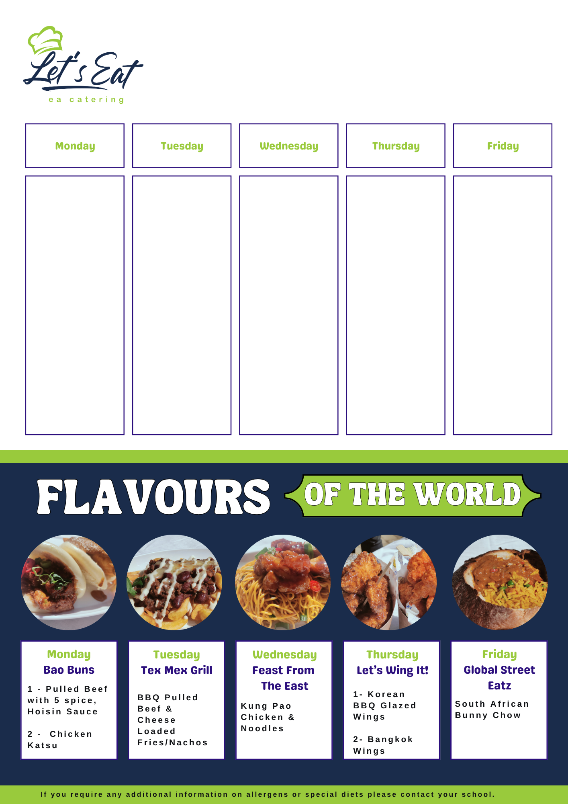
Glenlola Collegiate
week 1
Week Beginning:
06.10.25 20.10.25
03.11.25 17.11.25
01.12.25 15.12.25
29.12.25 05.01.26
19.01.25 02.02.26
16.02.26
Chicken Curry Boiled Rice & Naan Bread
Vegetable Enchiladas
Steak Burger & Cheese Slice
Baked Beans
Baked Potatoes
Mixed Salads
Diced Carrot & Peas
Chips
Curry Or Gravy Dip
Fresh Fruit Pots
Fruit Jelly
Fresh Yogurts
Ice-cream Tubs
Frozen Yogurts
Homemade Cookie
Beef Pasta Bolognese & Garlic Slice
Homemade Margaretta Pizza
Beef Stew
Crumbed Chicken Fillet Burger in Brioche Pap with Lettuce & Mayo
Tomato & Basil or Pesto Pasta
Seasonal Veg
Fresh Fruit Pots
Fruit Jelly
Chocolate Sponge & Custard
Homemade Cookie
Mixed Ice-cream Tubs
Homemade Pizza Slice
Chicken Curry with Rice & Naan Bread
Hot Dog
Baked Potatoes
Chips
Mixed Salads
Steak Burger & Cheese Slice
Seasonal Veg
Fresh Fruit Pots
Ice-cream Tubs
Homemade Cookie
Apple Crumble & Custard
Yogurts
Fruit Jelly
Roast of the Day
Seasonal Fresh Veg
Roast & Mashed Potatoes Savoury Stuffing & Gravy
BBQ Pulled Wrap
Chicken Curry Boiled Rice & Naan Bread
Homemade Pizza
Fresh Fruit Pots
Fruit Jelly
Ice-cream Tubs
Frozen Yogurts
Homemade Cookies
School Cake & Custard
Breaded Whiting with Slice of Lemon Mussy Peas / Petit Pois
Dirty fries
Chicken Curry & Boiled Rice & Naan Bread
Baked Potatoes
Chips Mixed Salads
Homemade Pizza
Baked Beans
Fresh Fruit Pots
Mixed Ice-cream Tubs
Homemade Cookies
Crackers & Cheese

Slide 2
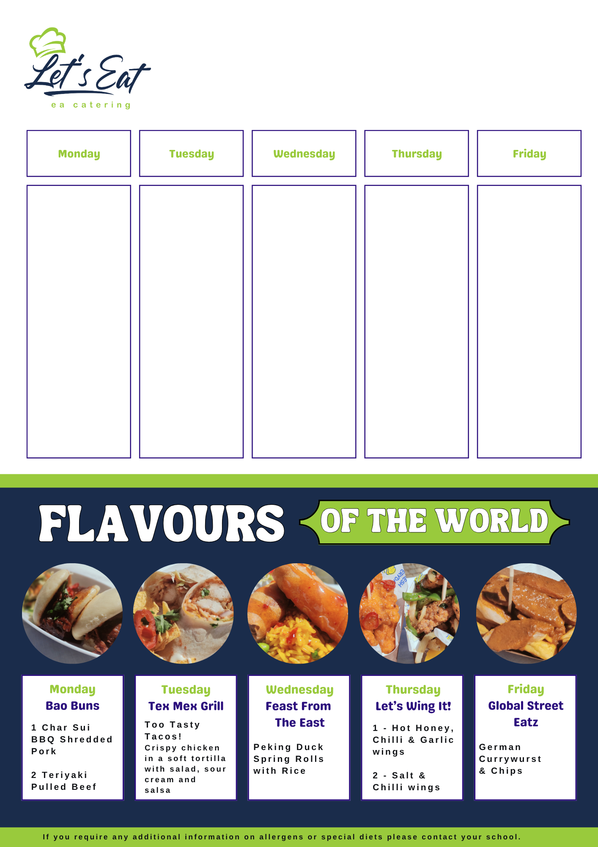
Glenlola Collegiate
Week 2
Week Beginning:
13.10.25 27.10.25
10.11.25 24.11.25
08.12.25 22.12.25
12.01.26 26.01.26
09.02.26 23.02.26
Beef Lasagne & Garlic Slice
Chicken Curry Boiled Rice & Naan Bread
Margaretta Pizza
Baked Potatoes
Chips
Mixed Salads
Spaghetti Hoops
Bacon & Cheese Loaded Fries
Mixed Veg
Fresh Fruit Pots
Variety of Yogurts
Mixed Ice-cream Tubs
Fruit Jelly
Beef Steak Pie
Fresh Seasonal Veg Champ
Vegetable Enchiladas
Crumbed Chicken Fillet Burger in Brioche Bap Lettuce & Mayo
Homemade Pizza
Mixed Salads
Angel Cake & Custard
Fresh Fruit Pots
Homemade Chocolate Cookies
Yogurt Selection
Katsu Chicken Curry, Boiled Rice & Naan Bread
Steak Burger / Cheeseburger
Tomato & Basil Meatball Pasta
Mixed Salads
Baked Potatoes
Chips
Homemade Pizza
Seasonal Veg
Fruit Crumble & Custard
Fresh Fruit Pot
Variety of Yogurts
Mixed Ice-cream
Pots
Wheaten Biscuit
Roast of the Day Seasonal Veg
Roast & Mashed Potato Stuffing & Gravy
Chicken Curry Boiled Rice & Naan Bread
Mixed Salad
Homemade Pizza Slice
Chicken & Broccoli Bake
Fresh Fruit Pots
Homemade Ginger Cookie
Shortbread
Fresh Yogurts
Ice-cream Tubs
Crackers & Cheese
Breaded Whiting Tartare Sauce Slice of Lemon
Mushy Peas
Chicken Goujons
Mixed Salads
Peas & Sweetcorn
Pizza Slice
Baked Potatoes
Chips
Spicy Bean Burger in Floury Bap
Baked Beans
Gravy & Curry Dips
Fresh Fruit Pots
Chocolate Brownie
Ice-cream Pots
Fruit Jelly
Fresh Yogurts

